Slide 1
Graph Neural Networks (GNN) for Large-Scale Network Performance Evaluation

Slide 2
Graph Neural Network
Graph Neural Network is a type of Neural Network which directly operates on the Graph data structure.
A typical application of GNN is node classification. Essentially, every node in the graph is associated with a label.
Graph neural networks (GNNs) are neural models that capture the dependence of graphs via message passing between the nodes of graphs.

Slide 3
GNNs are a hybrid of an information diffusion mechanism and neural networks that are used to process data, representing a set of transition functions and a set of output functions.
The information diffusion mechanism is defined by nodes updating their states and exchanging information by passing “messages” to their neighboring nodes until they reach a stable equilibrium.
The process involves first a transition function that takes as input the features of each node, the edge features of each node, the neighboring nodes’ state, and the neighboring nodes’ features and outputting the nodes’ new state.

Slide 4
Introduction
An adaptable network topology is necessary for traffic diversification.
For this reason, a good topology can minimize the number of hops in a traffic path, the likelihood of congestion, and queueing delays.
This effect is considerably more prominent in massive networks.
To improve the network performance in support of diverse traffic patterns (i.e., spatial and temporal traffic features), active studies on enabling network topological flexibility have occurred in recent years.

Slide 5
Issues with the Traditional Methods
Traditional network performance evaluation is complex.
As for the end-to-end latency, we commonly acquire a traffic arrival model, which is a stochastic process; and use queueing theory to deduce a general calculation formula.
In addition, for the network throughput, the linear programming (LP) model is often used.
The number of constraints is proportional to the square of the number of network nodes.
For a network with hundreds of nodes, a few tools can solve such a large LP model for network throughput, and it takes hours or days.
However, a network with topological flexibility expects to use online evaluation methods so that it can adapt to current traffic patterns in time.

Slide 6
Techniques used for Large-scale Network
With Topological Flexibility:
OpenScale
Flat-tree
LEONet
For Performance Evaluation:
End-to-end latency
Network throughput

Slide 7
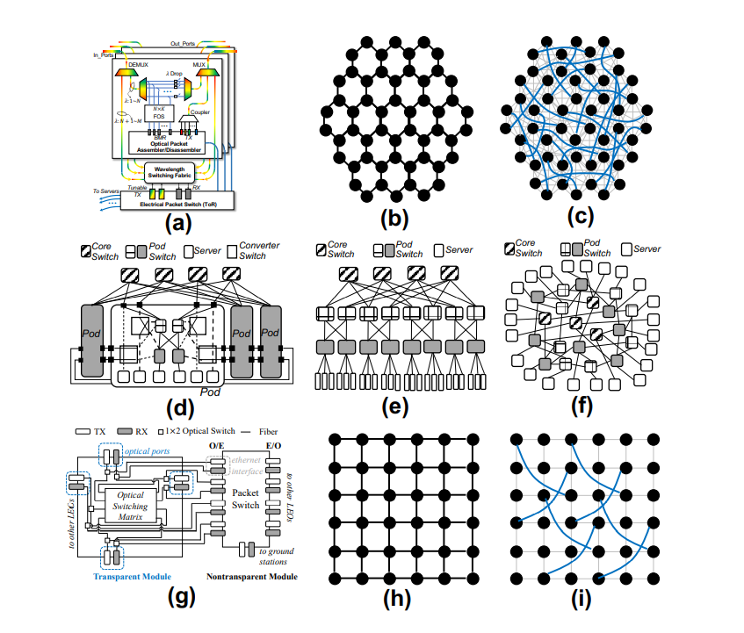
Techniques with Topological Flexibility for Large Scale Network

Slide 8
OpenScale
Each node belongs to three adjacent OPS-based rings; thus, one node is implemented with three sets of input/output ports.
For each input port, a DEMUX partitions wavelengths into two groups.
One group connects the wavelength switching fabric to build the direct lightpaths, and the other enters the fast optical switch (FOS).
The FOS selects the channels and forwards the drop traffic into the optical packet disassembler via burst mode receivers (BMRs).

Slide 9
The additional traffic in each node can be switched either to the lightpaths (i.e., OCS) or to the
optical packet assembler (i.e., OPS).
The OpenScale network has multiple hexagonal rings composed of such OCS+OPS nodes, as shown in Fig. 1 (b).
As shown by the blue paths in Fig. 1 (c), OpenScale uses OCS lightpaths to implement cross-ring connections without optical-electrical-optical (O-EO) conversion, which is free of queueing delay and congestion.
OPS, on the other hand, realizes intraring (i.e., time division multiplexing) meshed connections.

Slide 10
Flat-tree
In Fig. 1 (d), in a pod of the flat-tree, an original pod-server link and an original pod-core link are disconnected, and the corresponding servers, pod switches, and core switches are connected to two 4-port CSs and two 6-port CSs.
The 4-port CS has two alternative configurations.
The “default” configuration maintains a basic Clos topology, and the “local” configuration enables the server to connect the core switch directly.
The 6- port switch has two additional valid configurations: “side” and “cross”.

Slide 11
The “side” and “cross” configurations both relocate servers to core switches yet connect pod switches to their peers in different ways.
To retain a Clos pod, the CSs and the additional wiring are packaged together.
Flat-tree converts between multiple topologies with different CS configurations.
Fig. 1 (e) shows the Clos network in which all CSs are with the “default” configuration.
Fig. 1 (f) shows an approximate global random graph with the 4-port “local” and 6-port “side” configurations.

Slide 12
LEONet
Each LEO is equipped with a switching system, and its principle is similar to that on the ground.
One can forward Ethernet or IP packets using electrical packet switches (EPSs) according to the commercial standard digital video broadcasting (DVB) protocol.
In Fig. 1 (g), we additionally introduced an optical switching matrix on the node.
The optical switching matrix has 4 optical interfaces (i.e., a pair of transmitters and receivers), and EPS has 8 optical interfaces and 1 RF interface (to the ground gate station).

Slide 13
Four optical interfaces of the optical switching matrix and 4 optical interfaces of EPS are used to connect the adjacent LEOs via laser linking by spatial division multiplexing.
Each port of the optical switching matrix connects to a 1×2 optical switch. By configuring the optical switch, the 4 optical interfaces can be redirected to the other 4 interfaces on the EPS so that the traffic can either transparently pass the node or go to the EPS domain for packet parsing.
In this manner, over a basic LEO network topology with only one-hop intersatellite links (as shown in Fig. 1 (h)), optical lightpaths can be dynamically reconfigured between nonadjacent LEOs.
Fig. 1 (i) shows a type of topology called “Knit” [3].

Slide 14
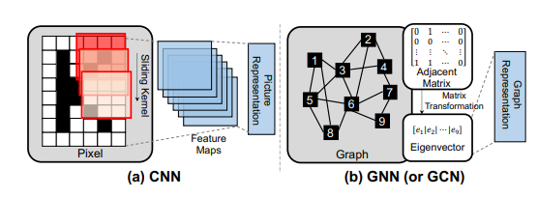
Graph Neural Network

Slide 15
Neural networks learn the representations of input data to obtain target results.
The basic CNN is shown in Fig. 3 (a), and it is suitable to process pixels.
The CNN uses multiple channels of sliding kernels to perform 2D convolution and obtains multiple feature maps.
Then, pooling layers can transform the feature maps into the representations of the pictures.

Slide 16
In contrast, the input of the GNN is a graph, as shown in Fig. 3 (b).
Although the popular GNN is called the graph convolutional network (GCN), no convolution operation is conducted.
The internal processing of the GCN is a type of matrix transformation (spectral analysis).
The GCN generates the eigenvectors of the graph and uses it to learn the graph representations.

Slide 17
Modeling Challenge
The challenge of using a GCN is to map both the network topology and traffic pattern into the first layer of the GCN, that is, how to determine H(0) and A.
Here, H(0) is the node feature matrix at layer 0 and A is the adjacent matrix of the graph.

Slide 18
Conclusion
The learning results show that the method described in the paper outperforms the fully connected network and convolutional neural network in the prediction error of the end-to-end latency and network throughput.
In addition, the authors showed that the method is significantly less time-consuming than traditional methods.

Slide 19
Thank you!

